Slide 1
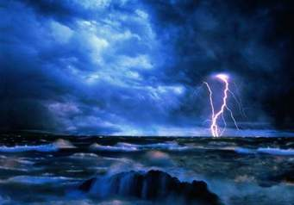
Terms & Definitions
By: sanaa gray

Slide 2

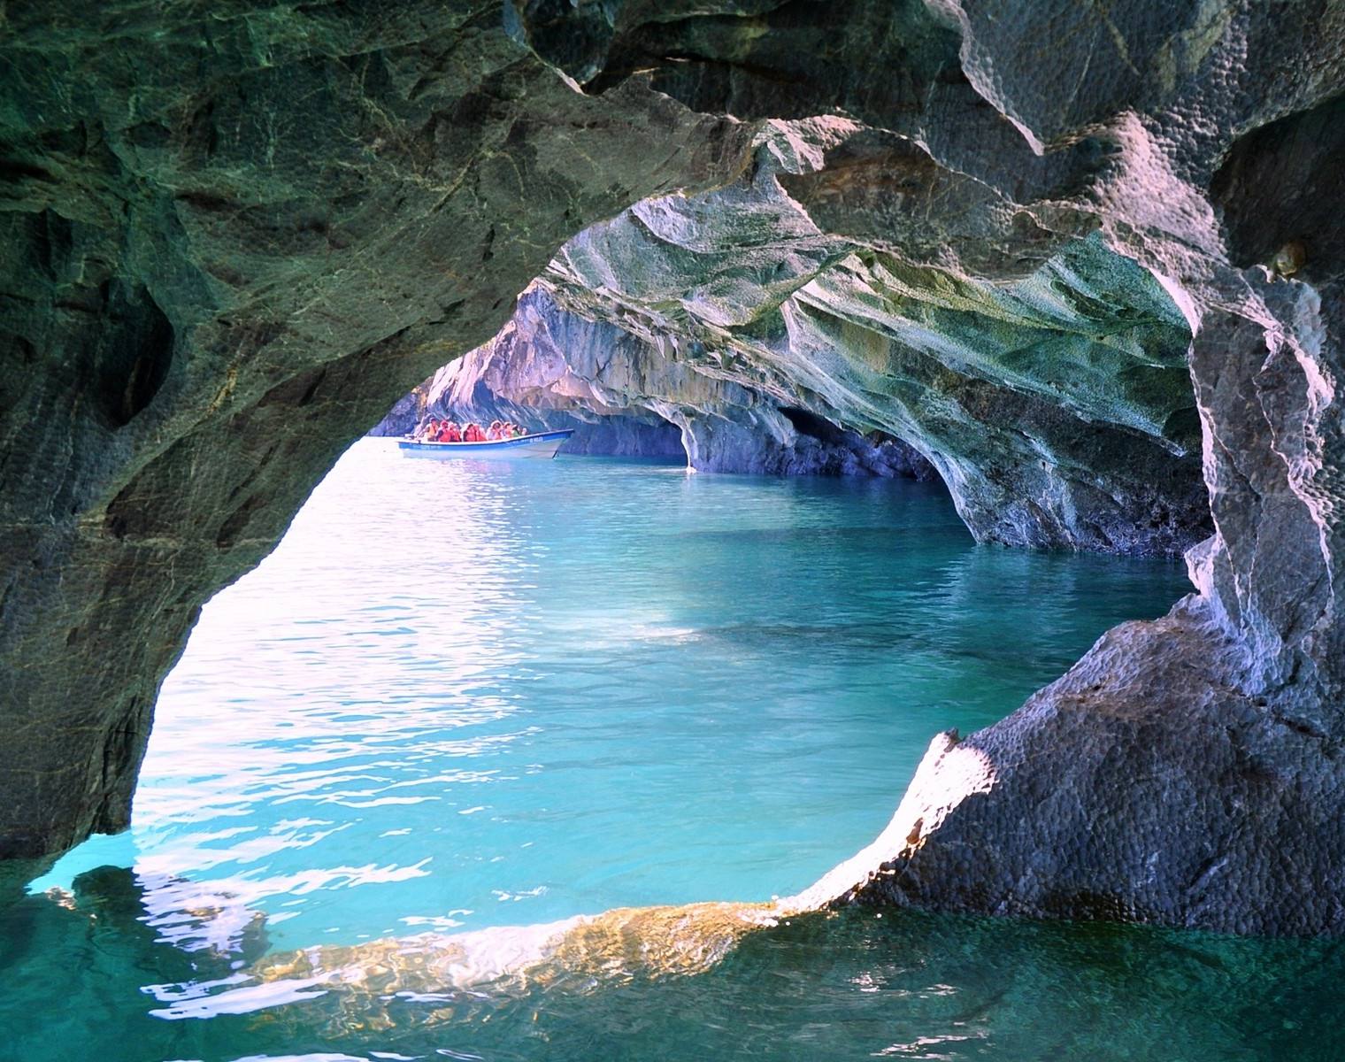
Erosion
The process of eroding or being eroded by wind, water or other natural agents

Slide 3

Sediment
Matter that settles to the bottom of a liquid; dregs

Slide 4
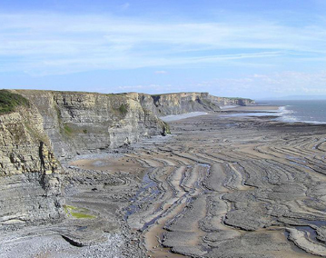
Deposition
Geologic process in which sediments soil and rocks are added to a land form or land mass.

Slide 5
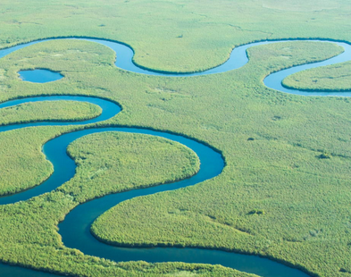
Meander
a winding curve or bend of a river or road.

Slide 6

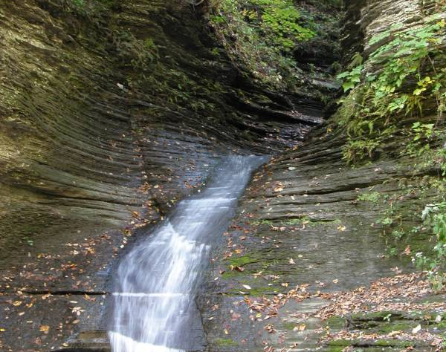
Gully
a water-worn ravine

Slide 7
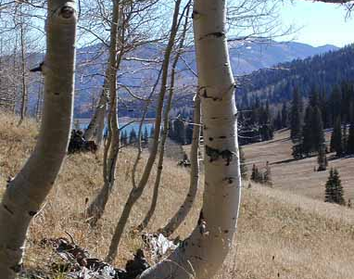
Creep
the tendency of a solid material to move slowly or deform permanently under the influence of mechanical stresses.

Slide 8
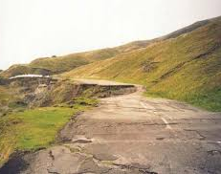
Slump
a form of mass wasting that occurs when a coherent mass of loosely consolidated materials or rock layers moves a short distance down a slope.

Slide 9
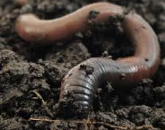
Decomposer
an organism, especially a soil bacterium, fungus, or invertebrate, that decomposes organic material.

Slide 10
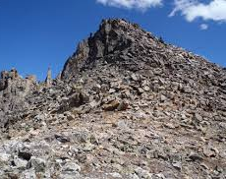
Abraded Rock
the mechanical scraping of a rock surface by friction between rocks and moving particles during their transport by wind, glacier, waves, gravity, running water or erosion.

Slide 11
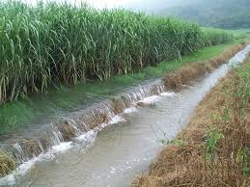
Runoff Areas
water, from rain, snowmelt, or other sources, that flows over the land surface, and is a major component of the water cycle.

